Slide 1
Used Cars Price Analysis
PRESENTED BY:
P.SURAJ REDDY

Slide 2
PROJECT OBJECTIVE
The objective of this project is to develop a web scraping tool that systematically extracts and analyses pricing data from the Cars Dekho website, Enabling users to gain insights into the used car market
By automating the collection of information such as car models, prices, specifications, and mileage, the project aims to facilitate comprehensive market analysis and comparison
This data driven approach will empower potential buyers, sellers and automotive analysts to make informed decisions based on real-time market trends, ultimately enhancing their understanding of vehicle valuation and pricing dynamics in the used car sector

Slide 3
MAIN AGENDA
Web Scrapping to collect the data
Data Cleaning and Manipulation
Visualization and Analysis on various factors like Fee, Location, infrastructure, collage type….etc.…. to analyze above problem statements.
An in-depth exploration of web scraping and data visualization using Python on the “Car Dekho” website to extract used car data across India. Learn the power of data extraction and visualization for insightful analysis of market analysis, prices, vehicle valuation , and fueltypes.

Slide 4
INTRODUCTION
The Automotive Market, Particularly The Used Car Segment, Is Characterized By Rapid Fluctuations In Pricing And A Diverse Range Of Options Available To Consumers.
By Leveraging Web Scraping Techniques, We Aim To Gather Essential Information Such As Car Models, Prices, Specifications, And Mileage, Which Can Be Analyzed To Identify Market Trends And Pricing Patterns.
The Project Will Utilize Python And Libraries Like Beautiful soup And Pandas To Automate The Data Collection Process, Ensuring Efficiency And Accuracy.
Ultimately, The Project Seeks To Enhance Transparency In The Used Car Market, Empowering Stakeholders To Align Their Decisions With Current Market Conditions And Expectations.

Slide 5
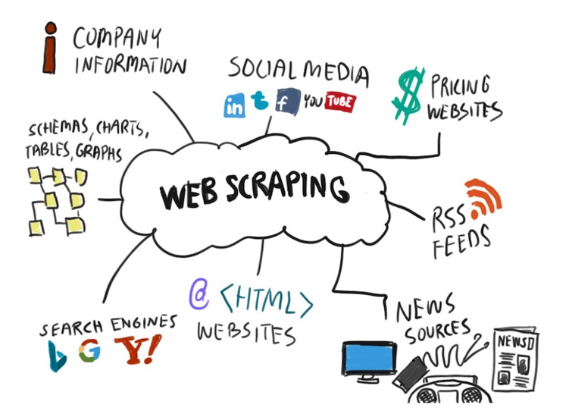
WEB SCRAPPING
Web Scraping Is The Process Of Automatically Extracting Data From Websites. It Involves Fetching The Content Of A Web Page And Parsing It To Retrieve Specific Information, Which Can Be Stored And Analyzed.
How It Works:
Fetching: A Web Scraper Sends A Request To A Web Server To Retrieve The HTML Content Of A Web Page.
Parsing: The Retrieved Html Is Then Parsed To Locate And Extract The Desired Data Elements, Such As Text, Images, Or Links.
Storing: The Extracted Data Is Typically Stored In A Structured Format, Such As A Csv File, Database, Or Spreadsheet, For Further Analysis.

Slide 6
TOOLS USED
Software Requirement:-
Python(Jupyter notebook)
Powerbi
Excel
Main Software Libraries:-
Pandas
Numpy
Beautiful Soups
Requests
CSV

Slide 7
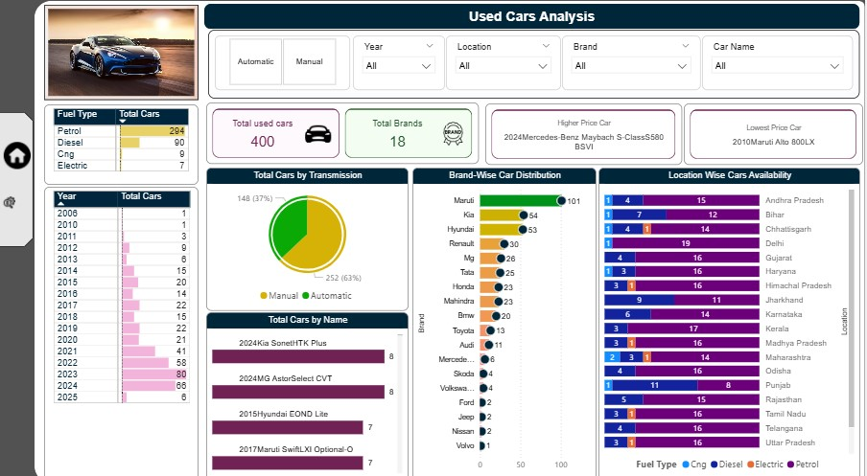
DASHBOARD’S

Slide 8
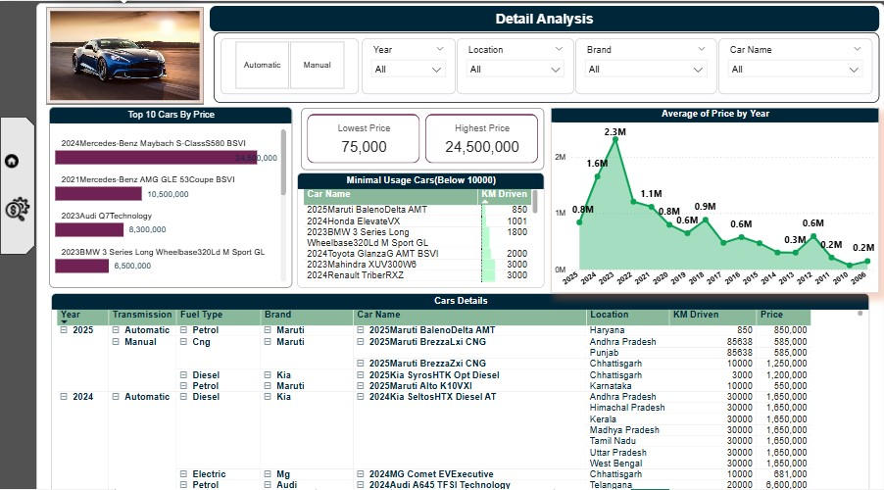

Slide 9
KEY INSIGHTS
Average price: The average price across the analyzed cars is ₹1.25M
Minimum Price: The minimum price ₹75000
Maximum Price: The maximum price ₹24500000
Count of Cars by Brand Distribution
A bar chart in the dashboard visualizes the number of cars each brand holds.
Maruti has the highest number of used cars, followed by Hyundai, kia, and Tata
Fuel and Transmission Distribution
Donut Chart: Distribution of cars by Fuel Type (Petrol, Diesel, CNG, Electric)
Pie Chart: Distribution by Transmission (Manual vs Automatic)
These visuals help users understand the market share of fuel options and transmission preferences in the used car segment.

Slide 10
THANK YOU

